Slide 1

SDET Course
Design Patterns - Strategy

Slide 2
3 Types of Design Patterns
Creational
Singleton
Builder
Prototype
Factory Method
Abstract Factory
Structural
Adapter
Composite
Proxy
Flyweight
Bridge
Facade
Decorator
Behavioral
Strategy
Observer
Command
Memento
State
Template Method
Mediator
Chain of Responsibility
Interpreter
Visitor
Iterator

Slide 3
Agenda
Description
Diagram
Code sample (Java)
Use cases

Slide 4

Description
Introduction - The Road Not Taken

Slide 5
Description
The Strategy Design Pattern is a behavioral design pattern that enables an object to change its behavior or algorithm at runtime. It involves defining a family of algorithms, encapsulating each one, and making them interchangeable within that family. The strategy pattern allows for the variation of the algorithm being used independently from the clients that use it. Essentially, it delegates the responsibility of executing a particular algorithm to a set of interchangeable classes known as strategies. This approach helps in avoiding conditional statements for selecting desired behaviors and promotes the use of composition over inheritance. By applying the strategy pattern, developers can choose the most suitable algorithm at runtime, enhancing flexibility and enabling easier testing and maintenance of the codebase.

Slide 6
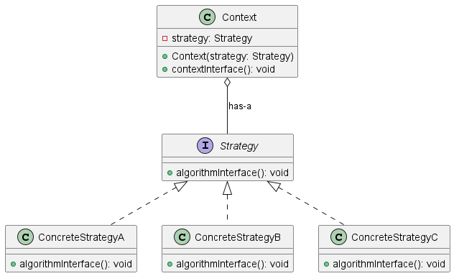
Class Diagram

Slide 7
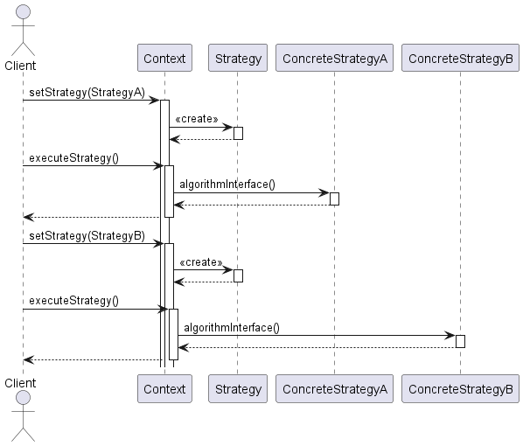
Sequence Diagram

Slide 8
Code Sample

Slide 9
Use cases
General
Different payment methods (credit card, PayPal, bank transfer, etc.)
Various compression algorithms (ZIP, RAR, TAR, etc.)
Social Media Sharing (Facebook, Twitter, Instagram, etc.)
In Test Automation
Test Data Generation (static datasets, dynamic data generation, data from files, etc.)
API Testing (REST, SOAP, GraphQL)

Slide 10
Happy Coding

